Slide 1
Foundations of Social and Cultural Data Analysis
Dr. Nanne van Noord & Dr. Melvin Wevers

Slide 2
Structured <-> Unstructured Data
Structured data is highly organized and formatted in a way that is easy for machines to read and query. It adheres to a predefined schema such as tables with rows and columns. (CSV, JSON, SQL)
Unstructured data lacks a predefined format or structure, making it more complex for computer programs to understand without advanced processing techniques. (Raw text, such as books, or emails)
Most data is unstructured data. We can add structure by applying processing methods such as Natural Language Processing or Computer Vision.

Slide 3
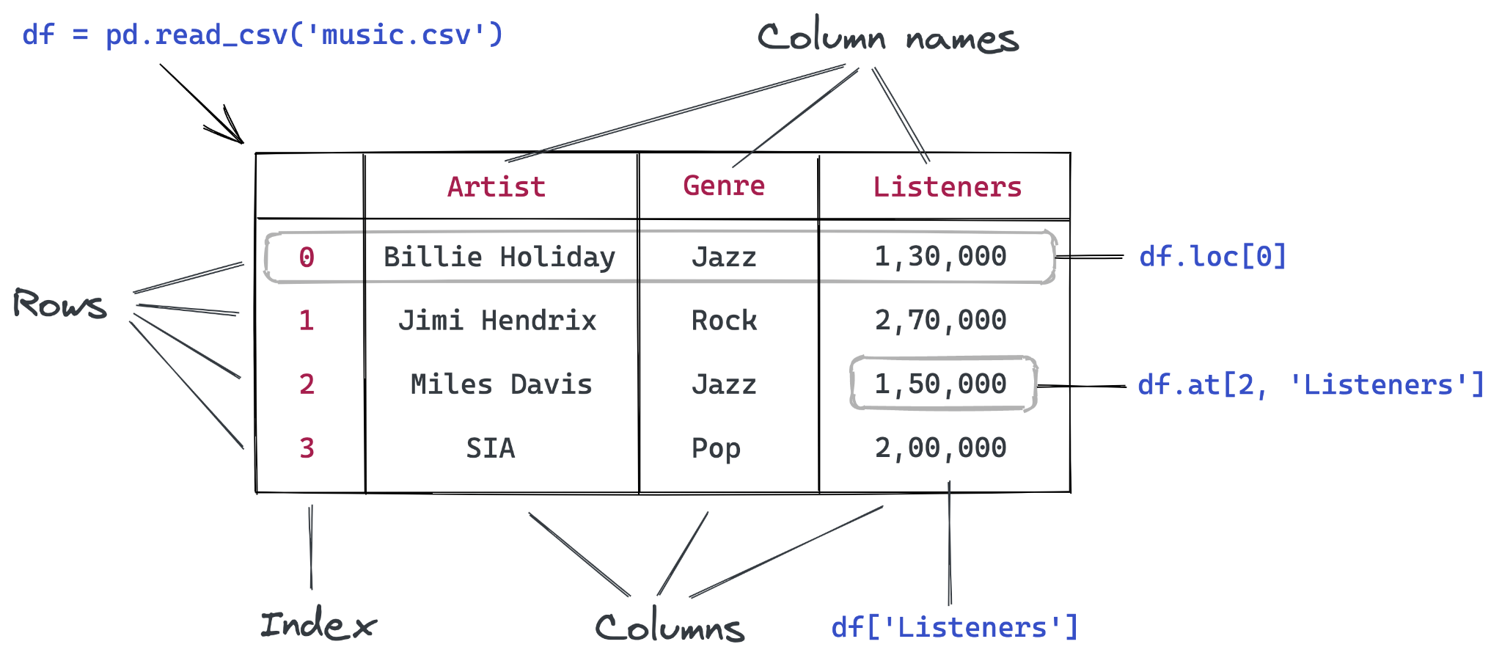
Tabular Data
Tabular data refers to data that is organized into tables composed of rows and columns. Each row represents a single record and each column represents a specific attribute or variable.

Slide 4
Data Transformations

Slide 5
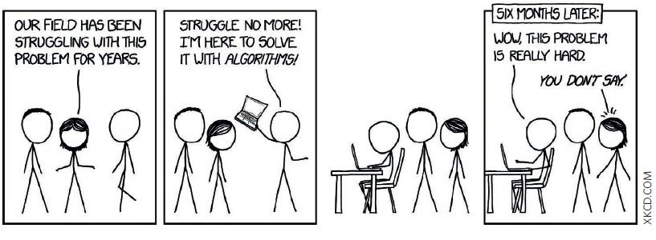
Data Transformations
Real world data is often very messy, and not in a format that readily enables analysis/visualisation.

Slide 6

https://pandas.pydata.org/getting_started.html

Slide 7
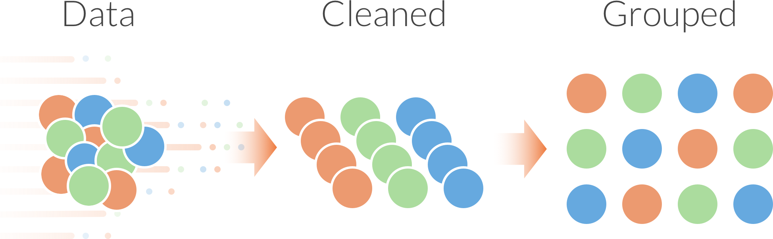
Data Transformations
Filter
Aggregate
Grouping
Sort
Concatenate
Join

Slide 8
Filter
Reducing a set of data based on certain criteria
Stad | Inwoners
Amsterdam | 853,312
Rotterdam | 639,587
Den Haag | 526,439
Utrecht | 344,384
Eindhoven | 227,100
Tilburg | 214,157
Stad | Inwoners
Amsterdam | 853,312
Rotterdam | 639,587
Den Haag | 526,439
df[df[‘inwoners’] > 500000]

Slide 9
Aggregate
Reducing a series of data to a single descriptive
City | Population
Amsterdam | 853,312
Rotterdam | 639,587
Den Haag | 526,439
Utrecht | 344,384
Eindhoven | 227,100
Tilburg | 214,157
df[‘inwoners’].mean()
Population | 467,496

Slide 10
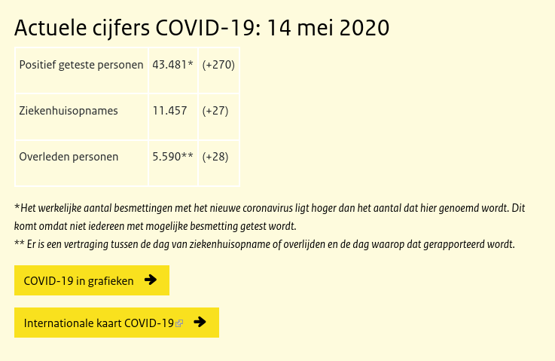
Aggregated data
https://www.rivm.nl/coronavirus-covid-19/actueel

Slide 11
Aggregation: Descriptive statistics
Aggregating is a way of summarising data
Measurement scale | Descriptive Statistic
Nominal | Frequency Relative Frequency (proportion) Percentage Mode
Ordinal | Frequency Relative Frequency (proportion) Percentage Mode Median
Interval and Ratio | Central tendency: mean, median, mode Range, standard deviation Interquartile range (IQR) Skewness, Kurtosis

Slide 12
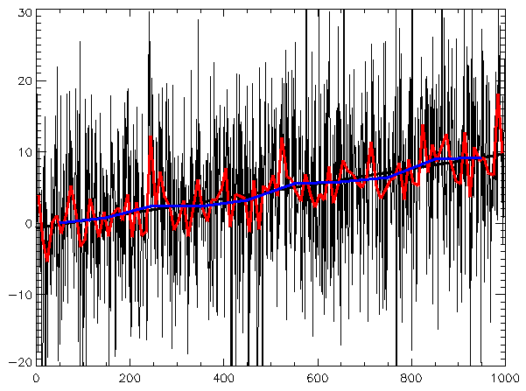
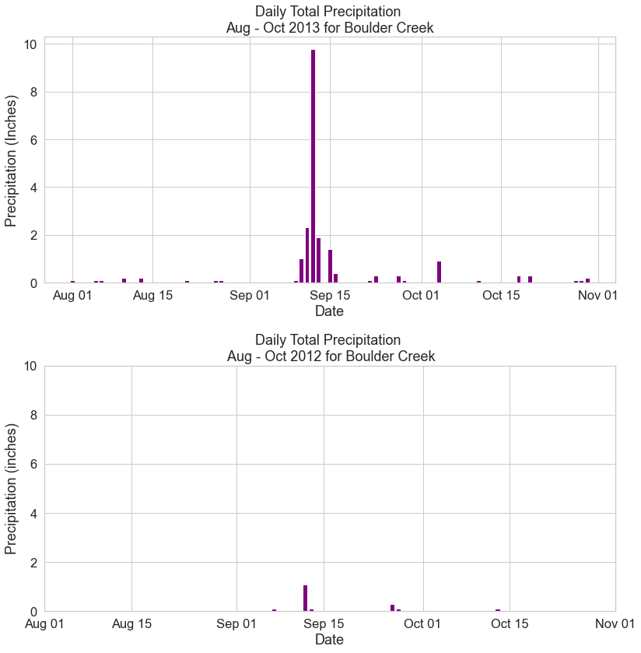
Plotting over Time: Time Series
Data points indexed in time order
import pandas as pd
df = pd.read_csv('data.csv')
df['date'] = pd.to_datetime(df['date'])# recognize data format
df.set_index('date', inplace=True)# set dates as index
df.resample(‘M’).mean #get monthly averages
df[‘2020-01’:‘2020-06’] # get data from january to june 2020

Slide 13
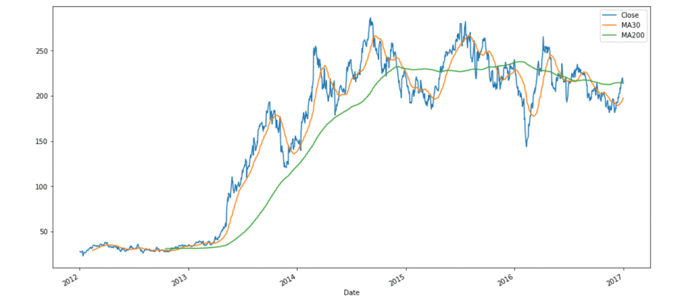
Plotting over Time: Rolling Mean
Rolling mean: A moving average that helps smooth out time series data.
Why? Easier to spot trends
rolling_mean = df['temperature'].rolling(window=7).mean()

Slide 14
Chaining transformations
City | Population
Amsterdam | 853,312
Rotterdam | 639,587
Den Haag | 526,439
Utrecht | 344,384
Eindhoven | 227,100
Tilburg | 214,157
df[df[‘Population’] > 500000].mean()
Population | 673,112
Pandas aggregation methods: https://pandas.pydata.org/pandas-docs/stable/api.html#api-dataframe-stats

Slide 15
Grouping
Dividing a dataset into coherent ‘subdatasets’
Followed by an aggregation
City | Province | Population
Amsterdam | Noord-Holland | 853,312
Rotterdam | Zuid-Holland | 639,587
Den Haag | Zuid-Holland | 526,439
Utrecht | Utrecht | 344,384
Eindhoven | Noord-Brabant | 227,100
Tilburg | Noord-Brabant | 214,157
Province | Population
Noord-Holland | 853,312
Zuid-Holland | 1,166,026
Utrecht | 344,384
Noord-Brabant | 441,257
df.groupby(‘Province’).sum()

Slide 16
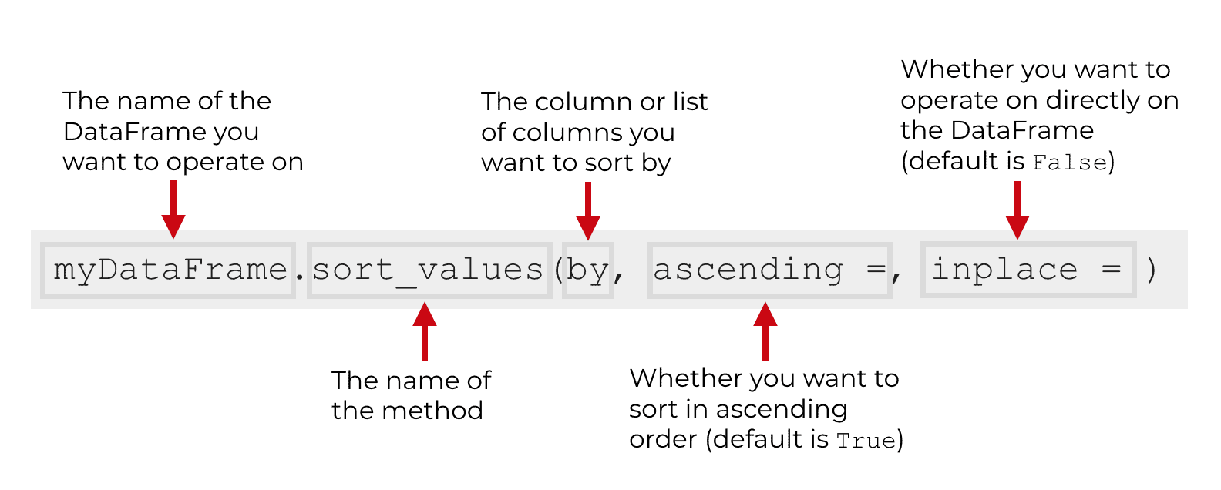
Sort
Ordering the values in a series
Useful for data inspection and presentation
.sort_values() in pandas

Slide 17
Concatenate
Combining multiple datasets which have the same variables
City | Population
Amsterdam | 853,312
Rotterdam | 639,587
Den Haag | 526,439
City | Population
Utrecht | 344,384
Eindhoven | 227,100
Tilburg | 214,157
+
=
City | Population
Amsterdam | 853,312
Rotterdam | 639,587
Den Haag | 526,439
Utrecht | 344,384
Eindhoven | 227,100
Tilburg | 214,157

Slide 18
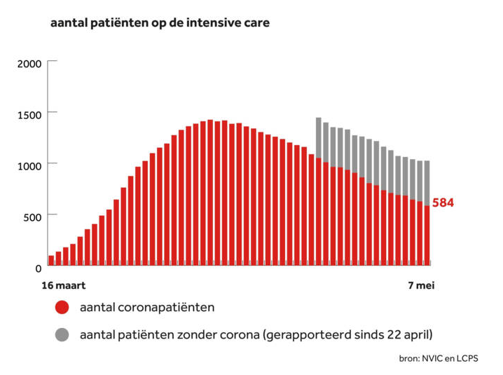
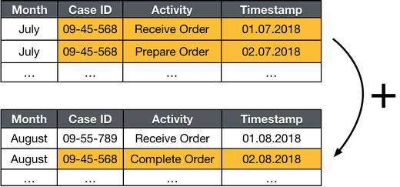
Concatenated data
Combine monthly records to form the basis of the annual report
Reported daily. Concatenated to form overview

Slide 19
Join
Combining two datasets which describe an overlapping set of instances, with different features
Powerful method to combine different data sources
Common in relational databases

Slide 20
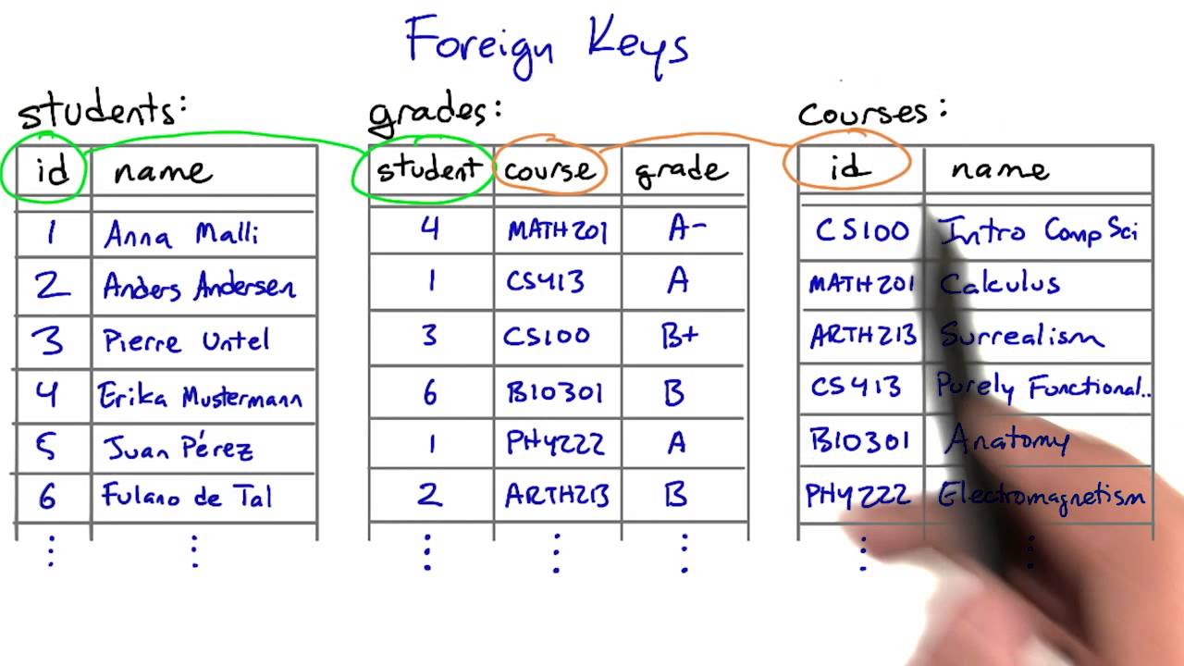
Keys
https://www.youtube.com/watch?v=fnbLMcd0FGQ

Slide 21
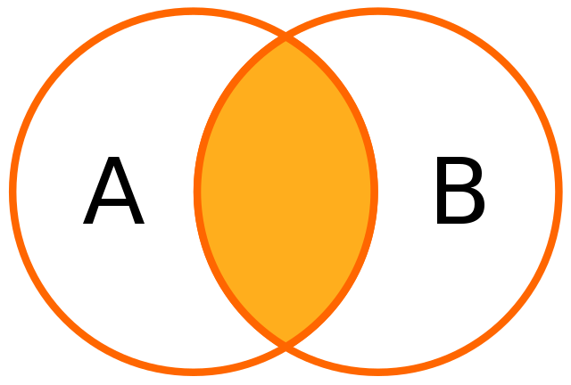
Inner Join
Image: wikipedia.org
Notes:
Inner joins return only the rows that have matching values in both tables, while outer joins include all rows from at least one of the tables, filling in NULL values for unmatched rows.

Slide 22
Inner Join
City | Population
Amsterdam | 853,312
Rotterdam | 639,587
Den Haag | 526,439
Utrecht | 344,384
Eindhoven | 227,100
Tilburg | 214,157
City | Air quality
Amsterdam | 42.4
Rotterdam | 40.9
Den Haag | 41.1
Utrecht | 41.4
Eindhoven | 43.8
Zwolle | 40.9
+
=
City | Population | Air quality
Amsterdam | 853,312 | 42.4
Rotterdam | 639,587 | 40.9
Den Haag | 526,439 | 41.1
Utrecht | 344,384 | 41.4
Eindhoven | 227,100 | 43.8

Slide 23
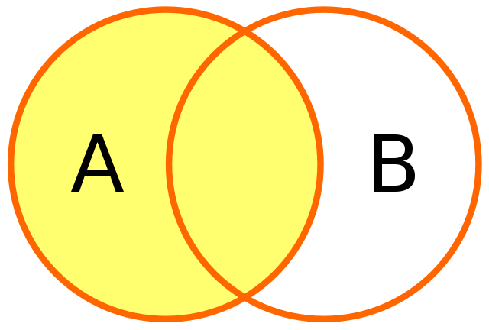
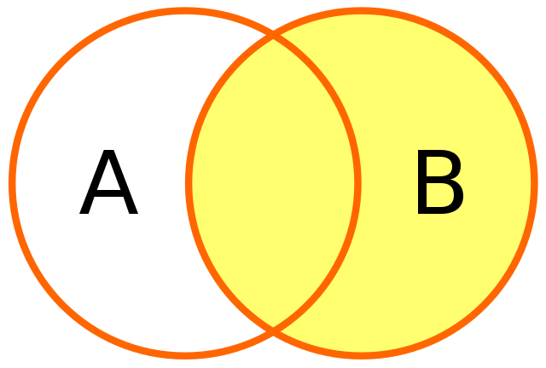
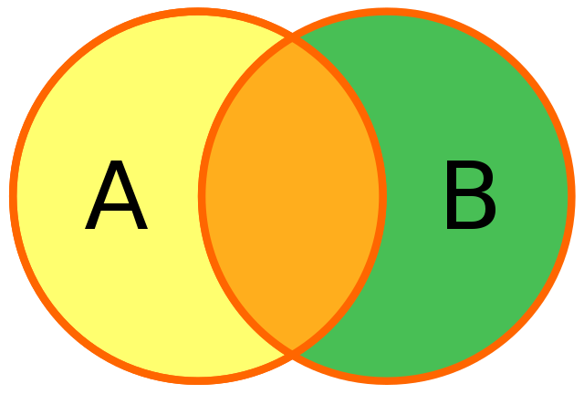
Outer Join
Left (outer) join
Right (outer) join
Full outer join
Images: wikipedia.org

Slide 24
Left Join
City | Population
Amsterdam | 853,312
Rotterdam | 639,587
Den Haag | 526,439
Utrecht | 344,384
Eindhoven | 227,100
Tilburg | 214,157
City | Air quality
Amsterdam | 42.4
Rotterdam | 40.9
Den Haag | 41.1
Utrecht | 41.4
Eindhoven | 43.8
Zwolle | 40.9
+
=
City | Population | Air quality
Amsterdam | 853,312 | 42.4
Rotterdam | 639,587 | 40.9
Den Haag | 526,439 | 41.1
Utrecht | 344,384 | 41.4
Eindhoven | 227,100 | 43.8
Tilburg | 214,157 | N/A

Slide 25
Right Join
City | Population
Amsterdam | 853,312
Rotterdam | 639,587
Den Haag | 526,439
Utrecht | 344,384
Eindhoven | 227,100
Tilburg | 214,157
City | Air quality
Amsterdam | 42.4
Rotterdam | 40.9
Den Haag | 41.1
Utrecht | 41.4
Eindhoven | 43.8
Zwolle | 40.9
+
=
City | Population | Air quality
Amsterdam | 853,312 | 42.4
Rotterdam | 639,587 | 40.9
Den Haag | 526,439 | 41.1
Utrecht | 344,384 | 41.4
Eindhoven | 227,100 | 43.8
Zwolle | N/A | 40.9

Slide 26
Full outer Join
City | Population
Amsterdam | 853,312
Rotterdam | 639,587
Den Haag | 526,439
Utrecht | 344,384
Eindhoven | 227,100
Tilburg | 214,157
City | Air quality
Amsterdam | 42.4
Rotterdam | 40.9
Den Haag | 41.1
Utrecht | 41.4
Eindhoven | 43.8
Zwolle | 40.9
+
=
City | Population | Air quality
Amsterdam | 853,312 | 42.4
Rotterdam | 639,587 | 40.9
Den Haag | 526,439 | 41.1
Utrecht | 344,384 | 41.4
Eindhoven | 227,100 | 43.8
Tilburg | 214,157 | N/A
Zwolle | N/A | 40.9

Slide 27
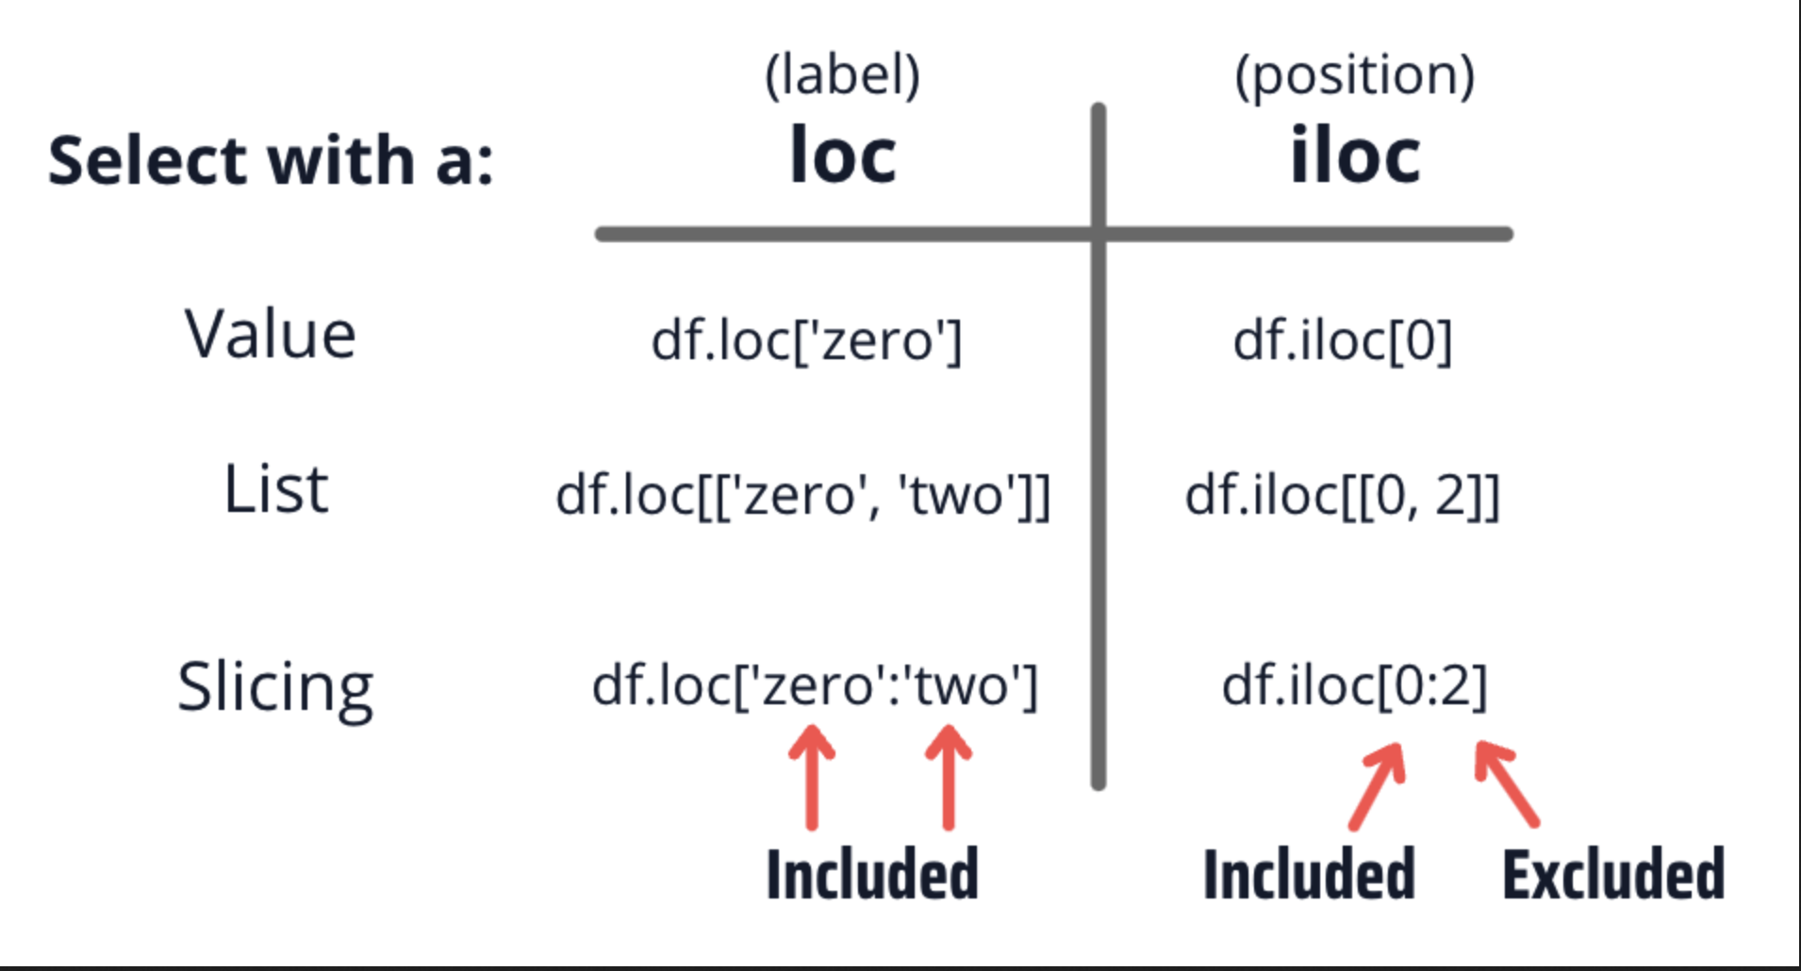
Indexing: iloc vs loc
iloc = Integer-based indexing
Loc = label-based indexing

Slide 28
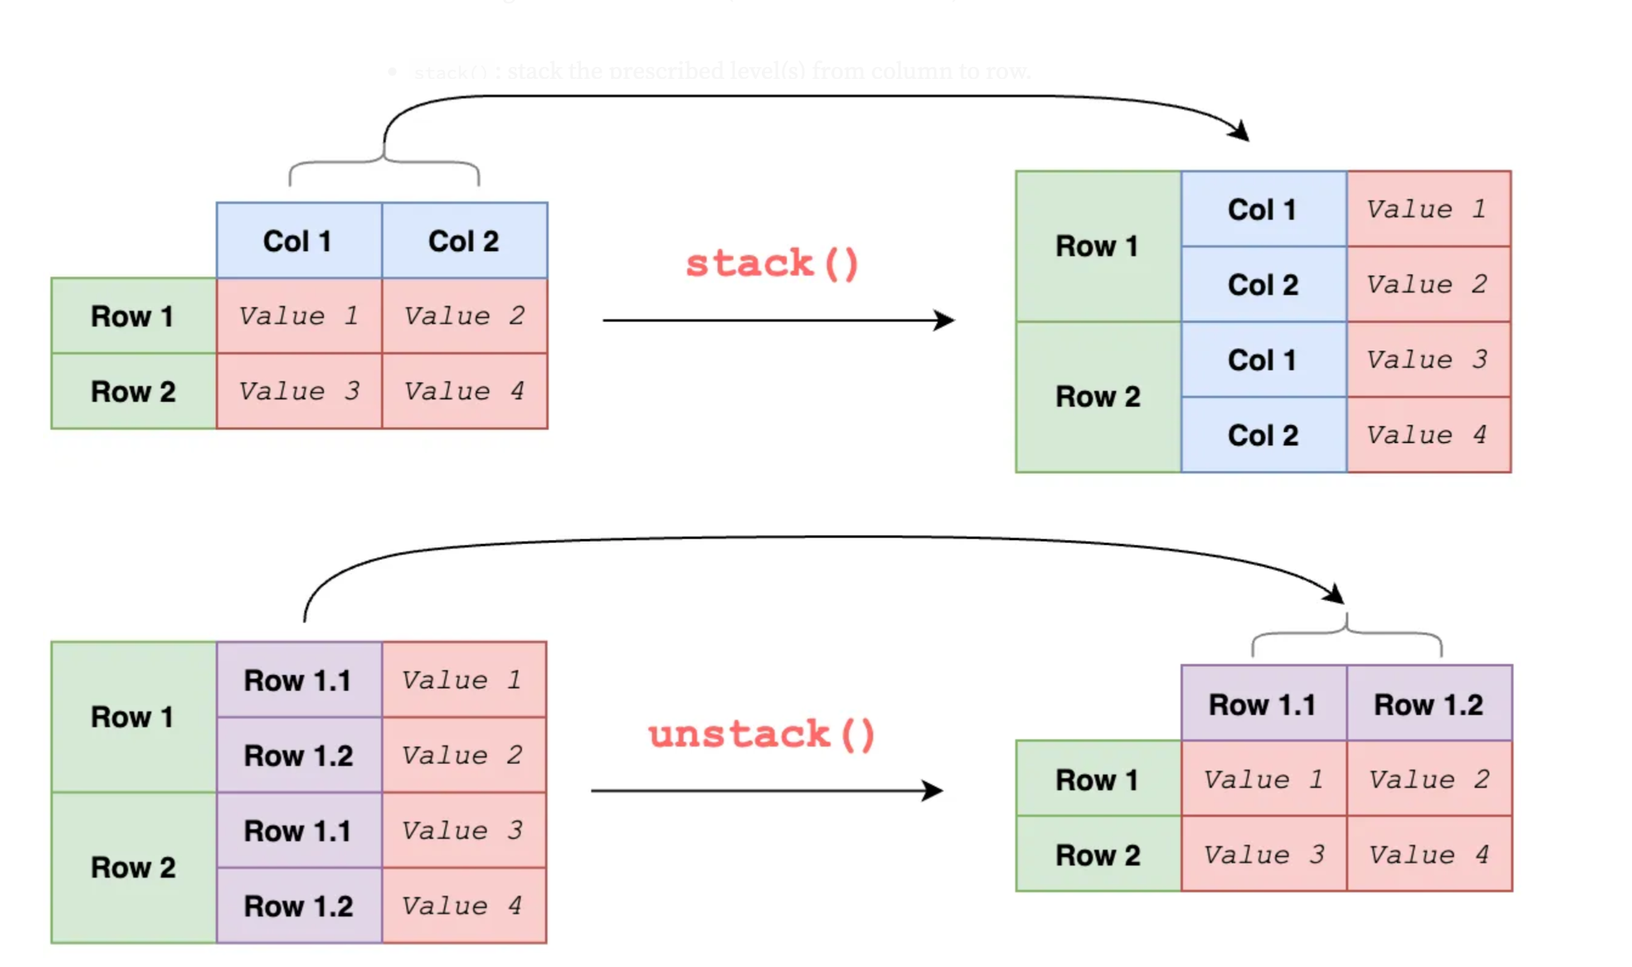
Stacking and Unstacking

Slide 29
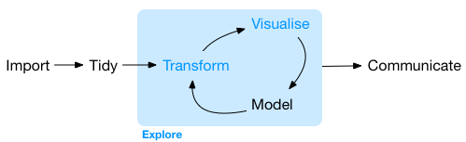
Goal
Transformations are not a goal on their own. We perform them to prepare the data for analysis and/or visualisation.
Image: https://aldosolari.github.io/DM/

Slide 30
Data Pre-processing

Slide 31
Data pre-processing
Selection
Importing
Cleaning
Normalisation

Slide 32
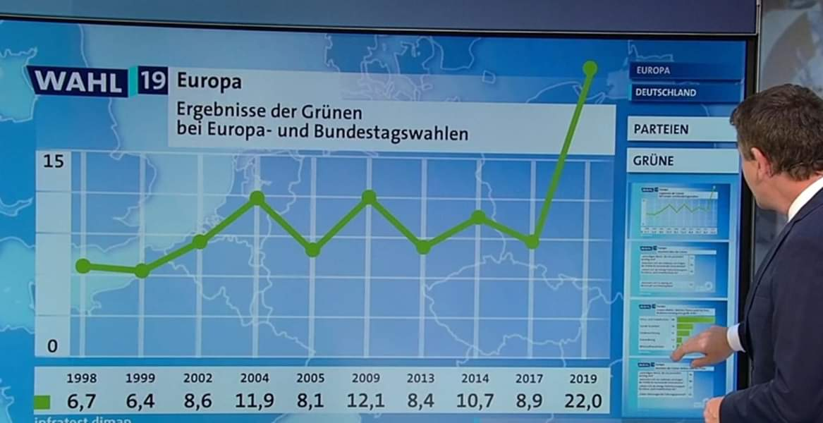
Incorrectly prepared data

Slide 33
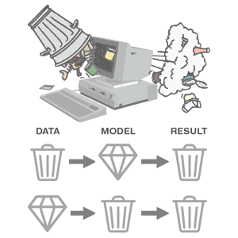

Garbage In, Garbage Out
https://medium.com/nyc-design/gigo-garbage-in-garbage-out-concept-for-ux-research-7e3f50695b82
https://thedailyomnivore.net/2015/12/02/garbage-in-garbage-out/

Slide 34
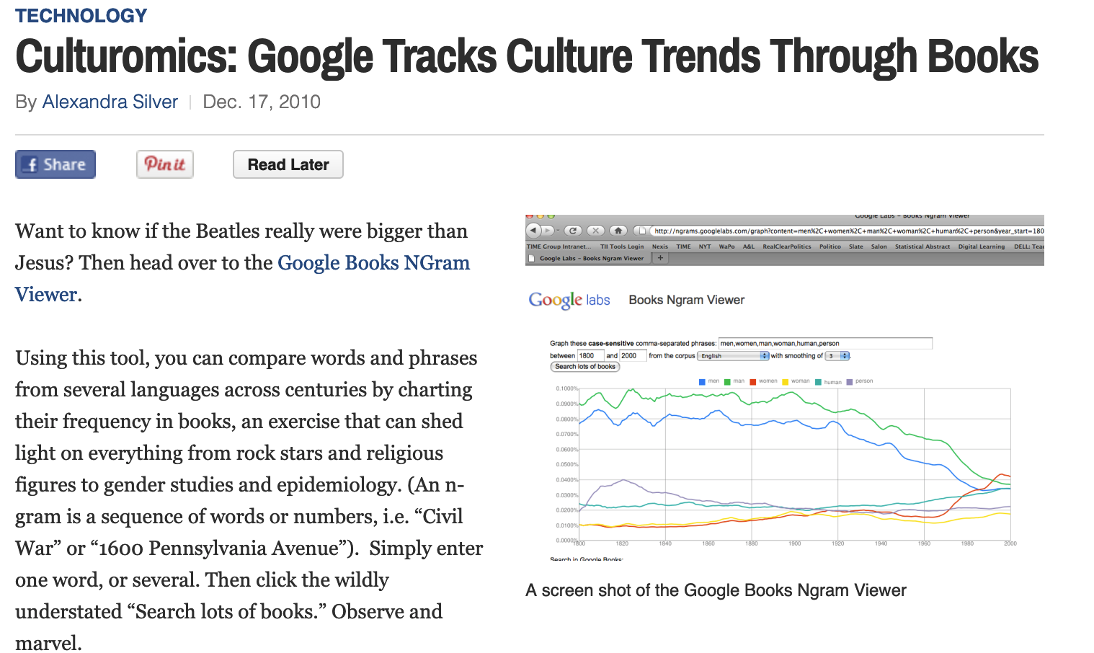
Google Books is heavily biased
“We find that only the English Fiction data set from the second version of the corpus is not heavily affected by professional texts” (Pechenick et al. 2015)
The corpus only encodes a small-scale kind of popularity, i.e. frequency of n-grams with all books given equal importance in their year of publication

Slide 35

Data Selection: Gathering
Before we can import data we need to ask:
What data do I need? → Follows from research question
What should it contain
How should it be structured
Where can I obtain this data?
Is the data available representative?

Slide 36

Data Selection: Reducing
What’s in my data (EDA) and do I need it all?
Out of scope
Privacy or ethical considerations
Practical reasons
Reduce by
Filtering
Removing attributes

Slide 37
Importing data
Highly dependent on format and software
Dataset might require conversion before we can even load it
File format conversion
Structural conversion
Document-based → Table

Slide 38

Data Cleaning
The goal of data cleaning is to ensure the quality of our dataset
Time consuming
Manual
Uncertain

Slide 39
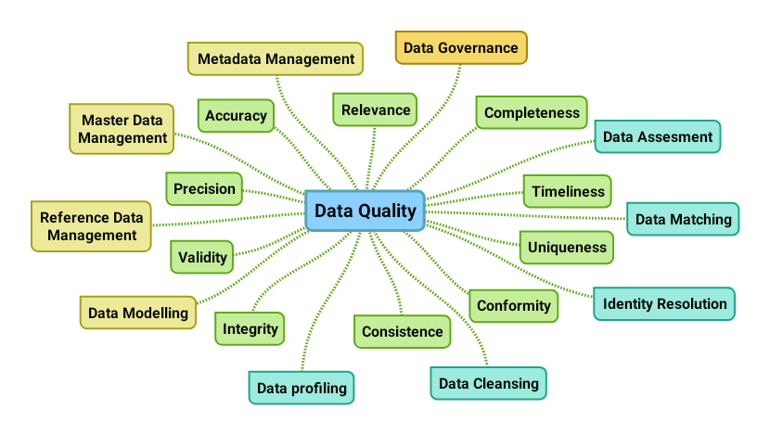
Data Quality
Accuracy: is the data correct?
Completeness: does it include all the relevant data?
Consistency: is my data equal across sources?
Validity: does it adhere to my requirements?
Uniqueness: is there duplicate data?
https://liliendahl.com/2019/04/20/a-data-quality-mind-map/

Slide 40
Data cleaning tasks
Data inspection (EDA)
Fix structural errors
De-duplicate
Remove outliers
Deal with missing values

Slide 41
De-duplicating
Removing duplicate records
Removing records that concern the same ‘key’
City | Population | Year
Amsterdam | 853,312 | 2018
Rotterdam | 639,587 | 2018
Den Haag | 526,439 | 2018
Utrecht | 344,384 | 2018
Eindhoven | 227,100 | 2018
Amsterdam | 862,965 | 2019
Utrecht | 344,384 | 2018

Slide 42
Structural errors
Typos
“Information Visuaisation”, “Information visualisation”, “Information Visualisation”
Mislabeled or inconsistent labeling
“N/A”, “Not applicable”, “NA”
“M”, “Female”, “F”, “male”, “Male”
Duplicate attribute names
Merging datasets that each have a ‘year’ column

Slide 43
Dealing with missing values
City | Population | Air quality
Amsterdam | 853,312 | 42.4
Rotterdam | 639,587 | 40.9
Den Haag | 526,439 | 41.1
Utrecht | 344,384 | 41.4
Eindhoven | 227,100 | 43.8
Tilburg | 214,157
Zwolle |  | 40.9
Listwise deletion
Column deletion
Imputation

Slide 44
Listwise deletion
Deleting records with missing values
City | Population | Air quality
Amsterdam | 853,312 | 42.4
Rotterdam | 639,587 | 40.9
Den Haag | 526,439 | 41.1
Utrecht | 344,384 | 41.4
Eindhoven | 227,100 | 43.8
Tilburg | 214,157
Zwolle |  | 40.9
Amsterdam | 853,312 | 42.4
Rotterdam | 639,587 | 40.9
Den Haag | 526,439 | 41.1
Utrecht | 344,384 | 41.4
Eindhoven | 227,100 | 43.8

Slide 45
Column deletion
Deleting attributes with missing values
City | Population | Air quality
Amsterdam | 853,312 | 42.4
Rotterdam | 639,587 | 40.9
Den Haag | 526,439 | 41.1
Utrecht | 344,384 | 41.4
Eindhoven | 227,100 | 43.8
Tilburg | 214,157
City | Population
Amsterdam | 853,312
Rotterdam | 639,587
Den Haag | 526,439
Utrecht | 344,384
Eindhoven | 227,100
Tilburg | 214,157

Slide 46
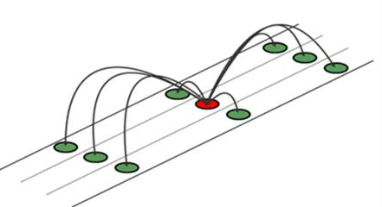
Missing values: Imputation
Substituting a missing value for a ‘plausible’ value
With a constant (U / 0)
Mean / median substitution
Random sampling (from distribution)
Modeling

Slide 47
Impute: constant
Replacing missing with an indicative value
City | Population | Air quality
Amsterdam | 853,312 | 42.4
Rotterdam | 639,587 | 40.9
Den Haag | 526,439 | 41.1
Utrecht | 344,384 | 41.4
Eindhoven | 227,100 | 43.8
Tilburg | 214,157 | NaN
Zwolle | NaN | 40.9
City | Population | Air quality
Amsterdam | 853,312 | 42.4
Rotterdam | 639,587 | 40.9
Den Haag | 526,439 | 41.1
Utrecht | 344,384 | 41.4
Eindhoven | 227,100 | 43.8
Tilburg | 214,157 | -1
Zwolle | -1 | 40.9
np.nanmean()

Slide 48
Impute: Mean substitution
Replacing missing values with mean value of series
City | Population | Air quality
Amsterdam | 853,312 | 42.4
Rotterdam | 639,587 | 40.9
Den Haag | 526,439 | 41.1
Utrecht | 344,384 | 41.4
Eindhoven | 227,100 | 43.8
Tilburg | 214,157
Zwolle |  | 40.9
City | Population | Air quality
Amsterdam | 853,312 | 42.4
Rotterdam | 639,587 | 40.9
Den Haag | 526,439 | 41.1
Utrecht | 344,384 | 41.4
Eindhoven | 227,100 | 43.8
Tilburg | 214,157 | 41,75
Zwolle | 467,496 | 40.9

Slide 49
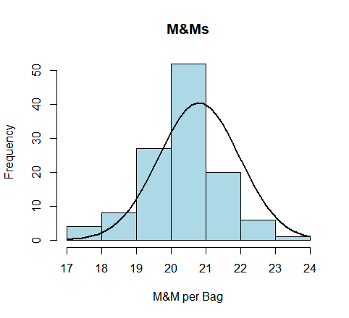
Impute: Random sampling
If we have a known distribution that fits the variable well we can sample from this distribution to generate a ‘plausible’ value.

Slide 50
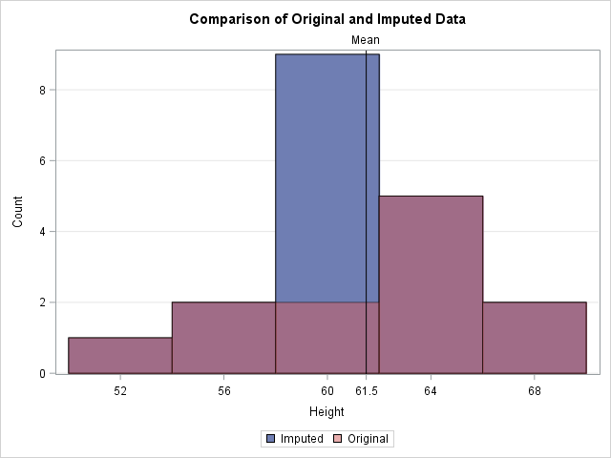
Risk of imputation
Likely to introduce bias to your dataset
Reflected in models
Might lead to incorrect conclusions

Slide 51
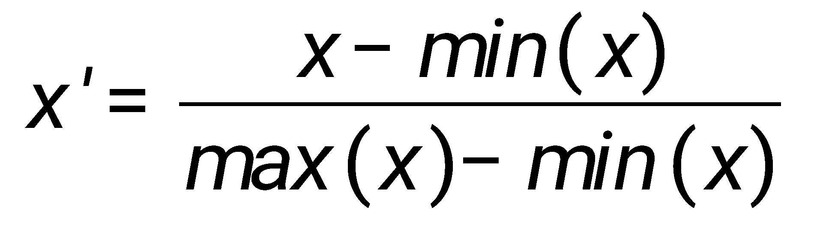
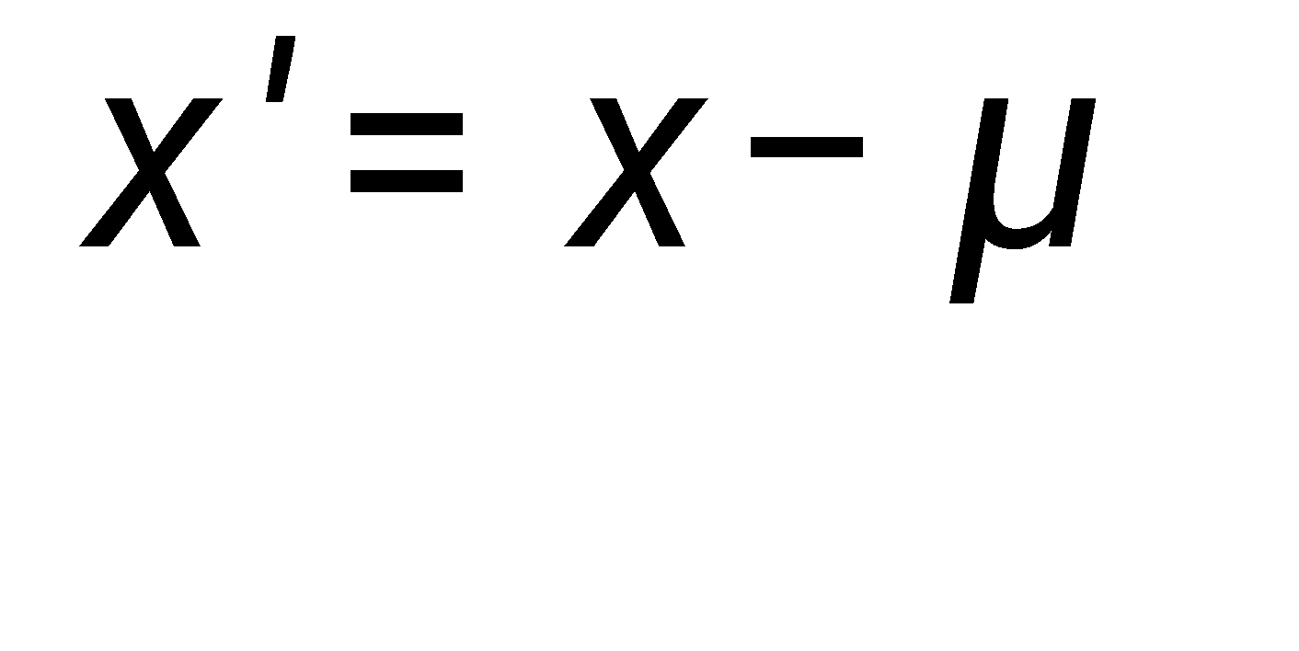

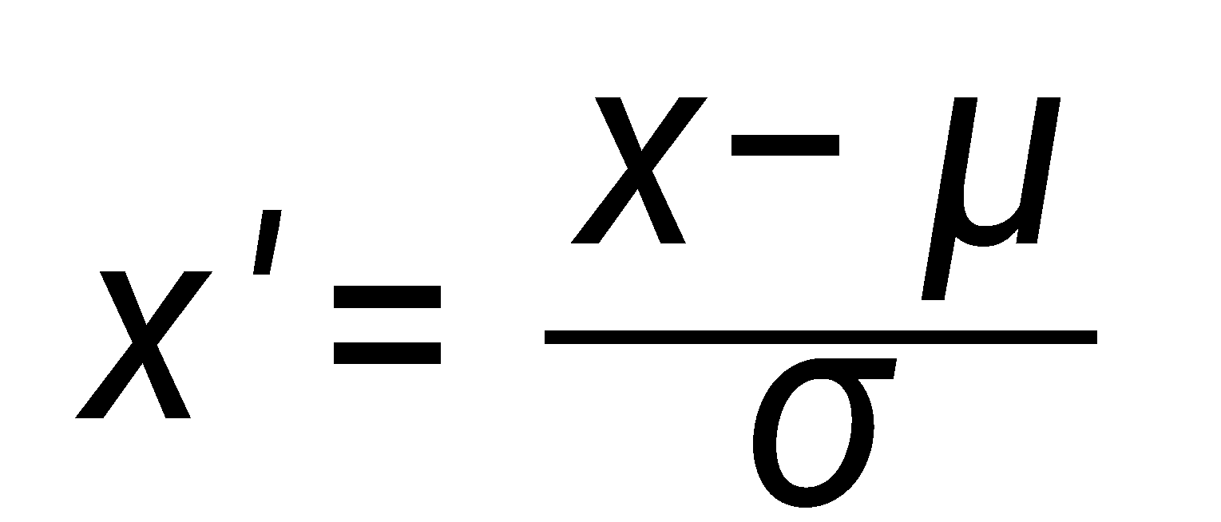
Normalisation
Mainly useful for modeling, but has use for visualisation too
Min-max scaling:
Scales values between 0 and 1
Zero mean:
Centers values around 0
Z-score
Centers values around 0
Score represents how many standard deviations it is from the mean

Slide 52
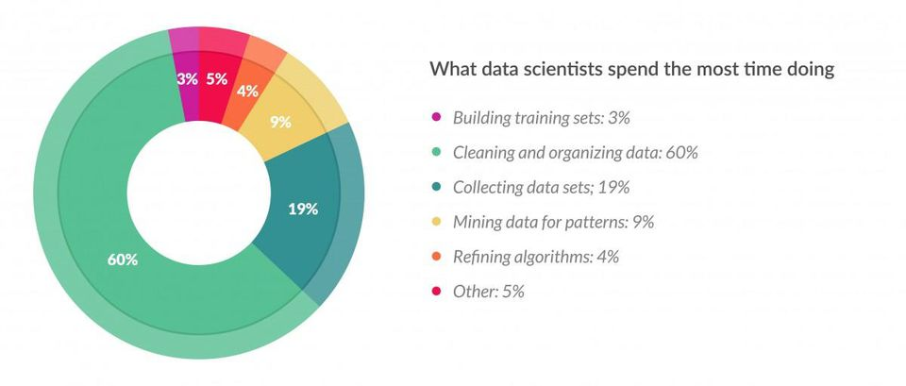
Wrap up
Pre-processing gets our data ready for further analysis
Familiarises you with the data
Time consuming
https://jinchuika.com/en/post/1-preprocessing-part-1/

Slide 53

Pandas readings
Intro to pandas objects: https://jakevdp.github.io/PythonDataScienceHandbook/03.01-introducing-pandas-objects.html
Data indexing and selection: https://jakevdp.github.io/PythonDataScienceHandbook/03.02-data-indexing-and-selection.html
Combining datasets: Merge and join: https://jakevdp.github.io/PythonDataScienceHandbook/03.07-merge-and-join.html
Aggregation and grouping: https://jakevdp.github.io/PythonDataScienceHandbook/03.08-aggregation-and-grouping.html

